Slide 1

AIR BNB HOTEL BOOKING ANALYSIS
[AKHIL SINGH ]
[STU67e28cd4daeac1742900436]

Slide 2

PROBLEM STATEMENT
Airbnb has changed how people travel and book places to stay. With thousands of options available in different cities, travelers often face difficulties in selecting the right accommodation that matches their budget, location preference, and comfort. At the same time, hosts need to set fair prices and manage their listings to attract bookings. Understanding patterns in prices, availability, and customer reviews is important. This analysis focuses on identifying these patterns to make the booking process clearer for both guests and hosts.

Slide 3
Project Description This project is based on analyzing Airbnb hotel booking data to gain useful insights into how the platform functions. The dataset includes information about listings such as room type, neighborhood, price, reviews, and availability. By cleaning and examining the data, the project highlights which neighborhoods are more popular, what type of rooms are in demand, how prices vary, and how reviews impact bookings. The study uses visualizations and statistical methods to present the findings in a clear way, helping travelers and hosts understand trends and make better choices.

Slide 4

WHO ARE THE END USERS?
Travelers/Guests → People using Airbnb to book affordable and convenient accommodations. They benefit from insights into prices, popular neighborhoods, and room types.
Hosts → Property owners who list their rooms/homes. They can use the findings to set competitive prices, adjust availability, and improve their listings.
Airbnb Company → The platform itself can use the analysis to understand market trends, improve recommendations, and enhance customer satisfaction.
Researchers & Analysts → People studying travel trends, pricing strategies, and customer behavior.

Slide 5

Technology Used
The project is developed using Google Colab as the main environment for coding and analysis. The dataset is handled with Python, where libraries such as Pandas and NumPy are used for data cleaning and preparation. For data visualization and pattern discovery, tools like Matplotlib and Seaborn are applied to create charts and plots. Google Colab also enables easy integration with Google Drive for storing and accessing datasets. File Handling libraries for Openpyxl (for excel) and built in csv file handling. These technologies together provide a reliable and efficient setup for analyzing Airbnb booking data.

Slide 6
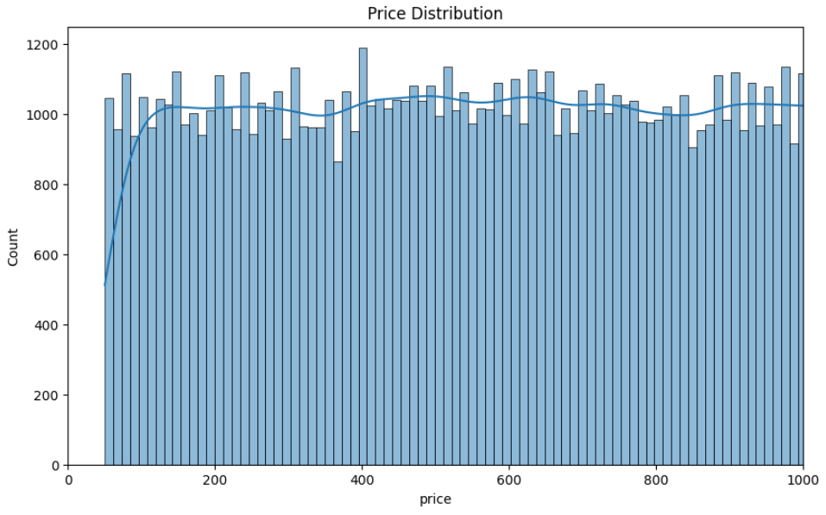
RESULTS1
Demo Link

Slide 7
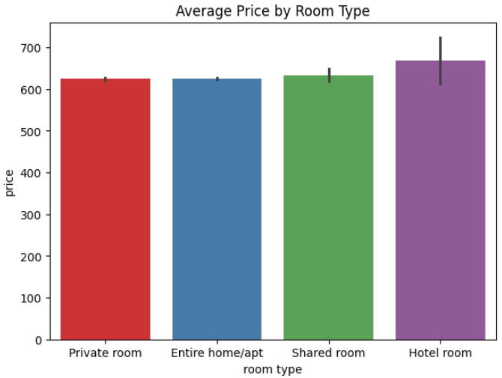
RESULTS2
Demo Link

Slide 8
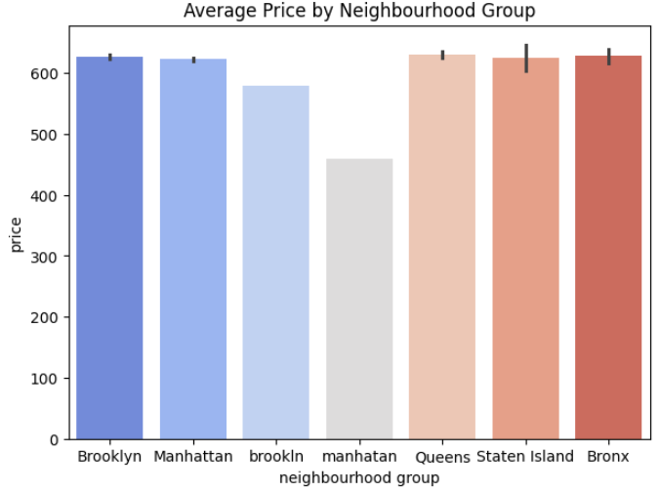
RESULTS3
[Add screen shots of your code or Chart(s) ]
Demo Link

Slide 9
GitHub repository
[https://github.com/akhil-singh-jee/VOIS_AICTE_OCT2025_AKHIL-SINGH-JEE.git ]
Demo Link

Slide 10
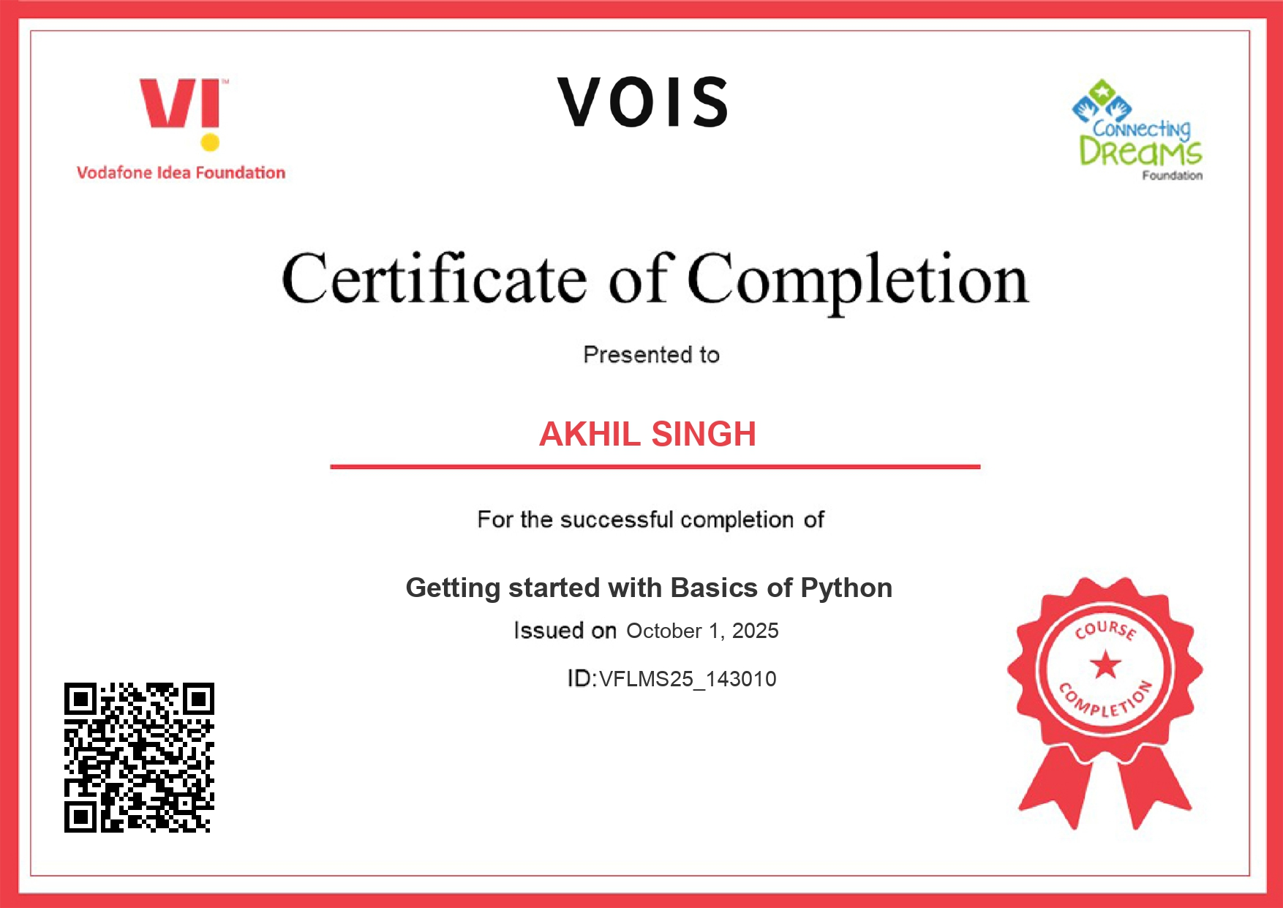
Getting started with Basics of Python Certificate
[Paste your Certificate Here]

Slide 11

Data Visualization Certificate
[Paste your Certificate Here]

Slide 12
Thank you
.
.

